Slide 1
Microservers
Introduction to Microservers By Dilan O.

Slide 2

What is Microservers?
is an architectural style.
is a method of developing software.
set of services that run independently and autonomously.
For large and complex apps.

Slide 3
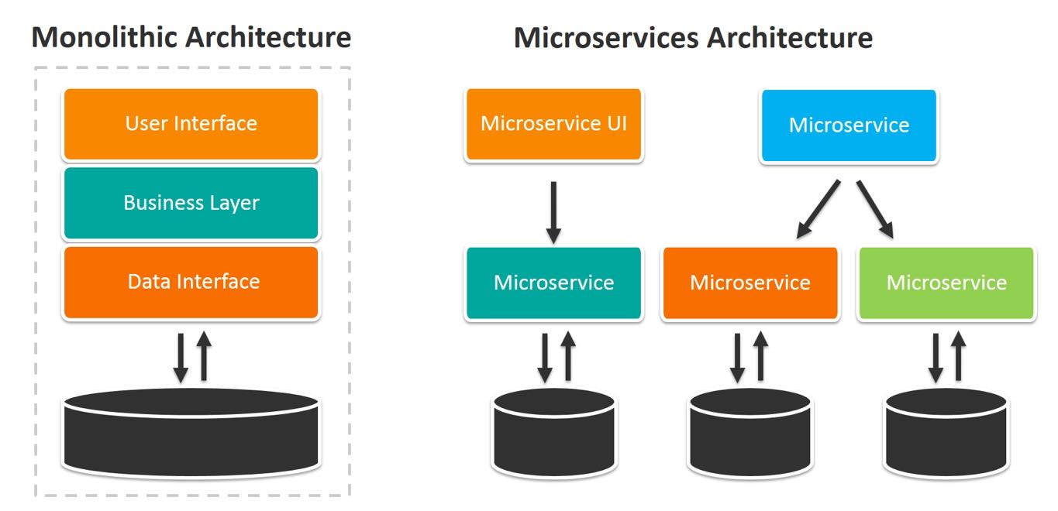
Characteristics:
Modularity, can be developed maintained and deployed independently.
Code can be written in different languages.
Easy to understand and modify for developers.
Scaling up becomes easier.

Slide 4
Cons:
Initial time investment: When building the architecture, it takes more time to be able to fragment the various microservices.
Debugging becomes more challenging with microservices.
Costs may be higher with microservices: hosting infrastructure with security and maintenance support.
Developer profile: need skilled development teams.

Slide 5
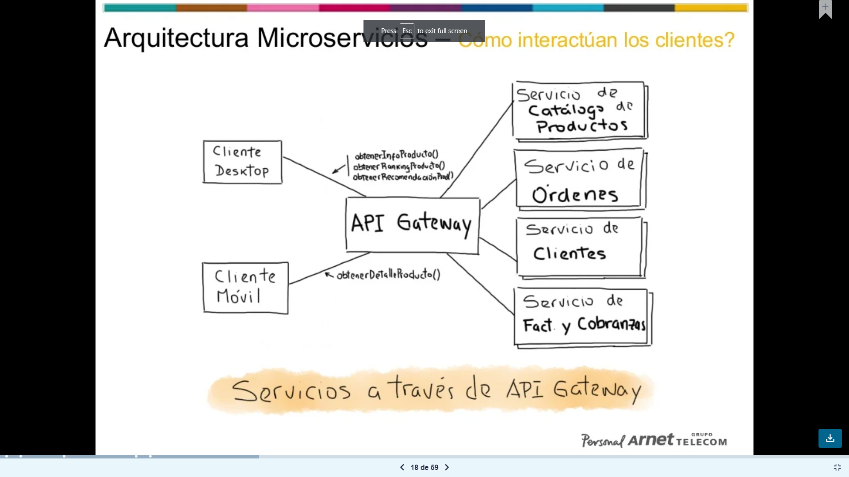
Communication:
It is like an entry point.
Process:
A client sends a request to the gateway.
The gateway processes and sends the request to the Service.
The service responds to the gateway.
The gateway processes the response and sends it to the client.
Authentication.
Validate variables.

Slide 6
When to use?
Large and complex apps.
Projects with a great team.
Frequent and continued deployments.
Have experience in microservices.

Slide 7
That’s all. Thank you…

